Slide 1
Cyclistic Case Study
By: Ayodeji Yekeen
Last Updated: December 18th, 2021

Slide 2
What are we talking about?

Slide 3
Objective
Identifying how annual members and casuals differ , why casual riders would buy a membership and converting casual riders into annual members.

Slide 4
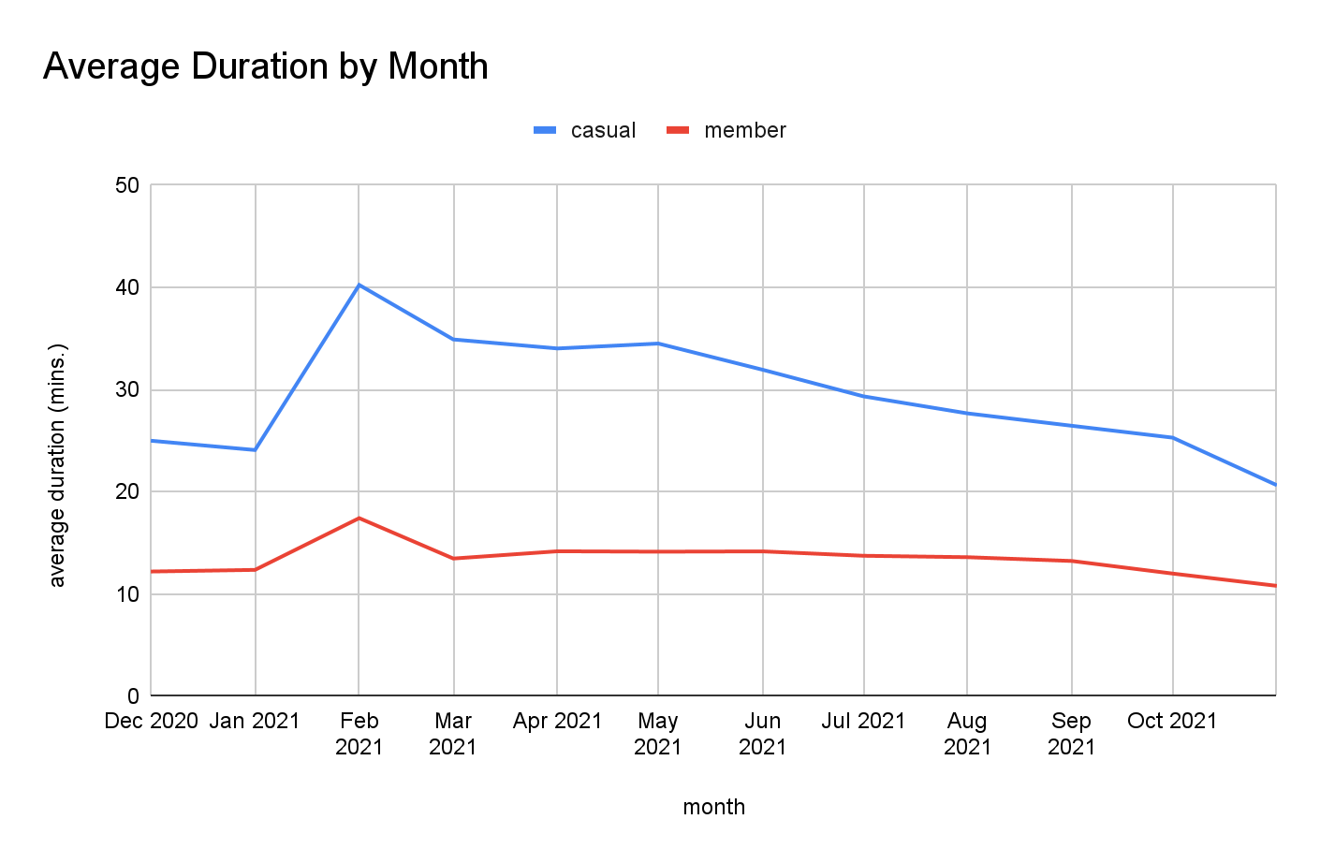

Slide 5
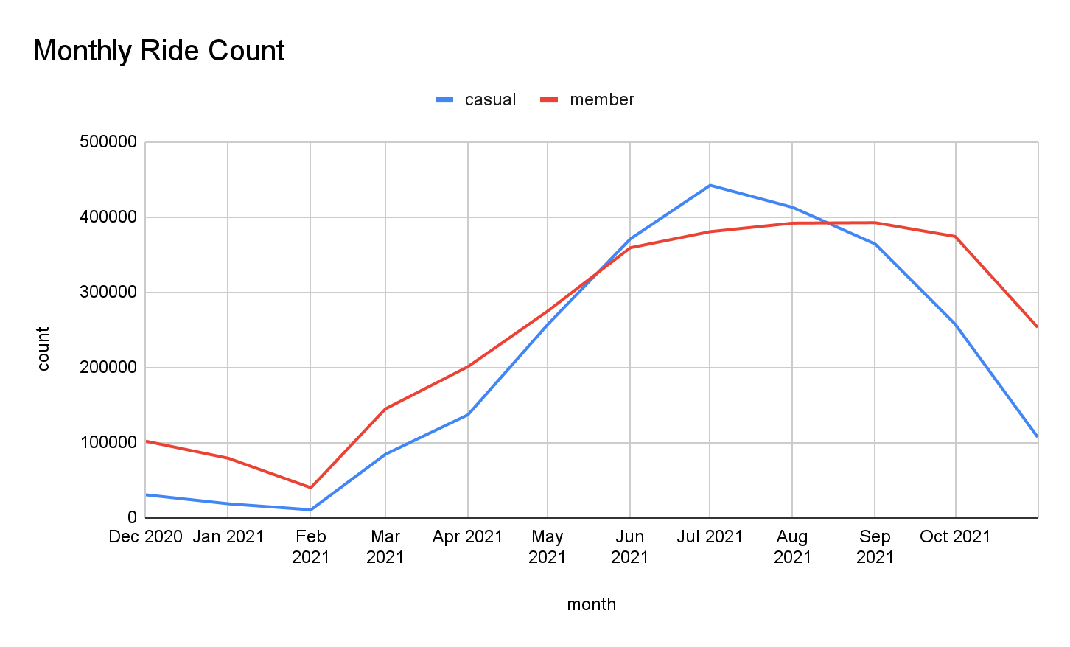

Slide 6
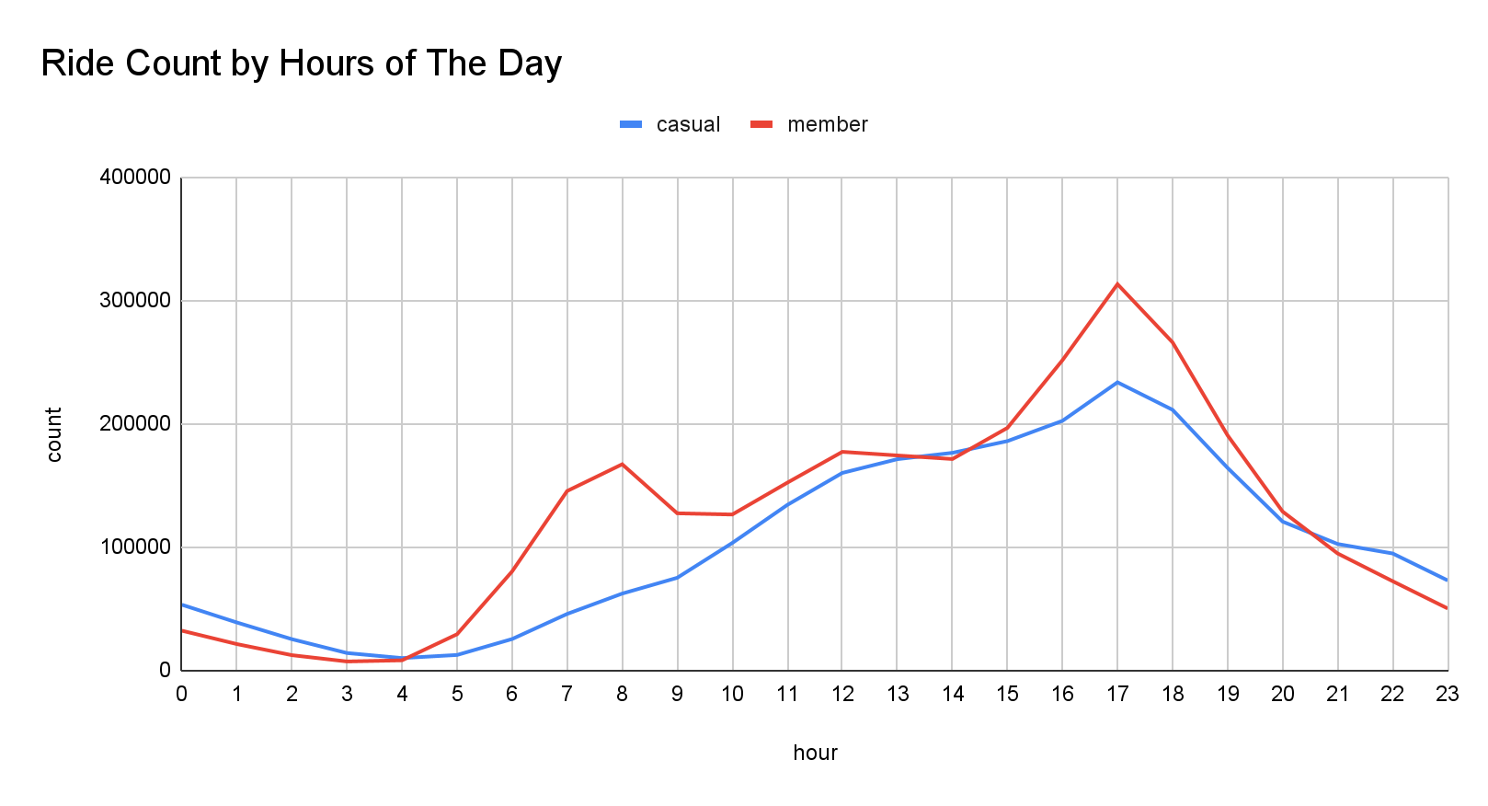

Slide 7
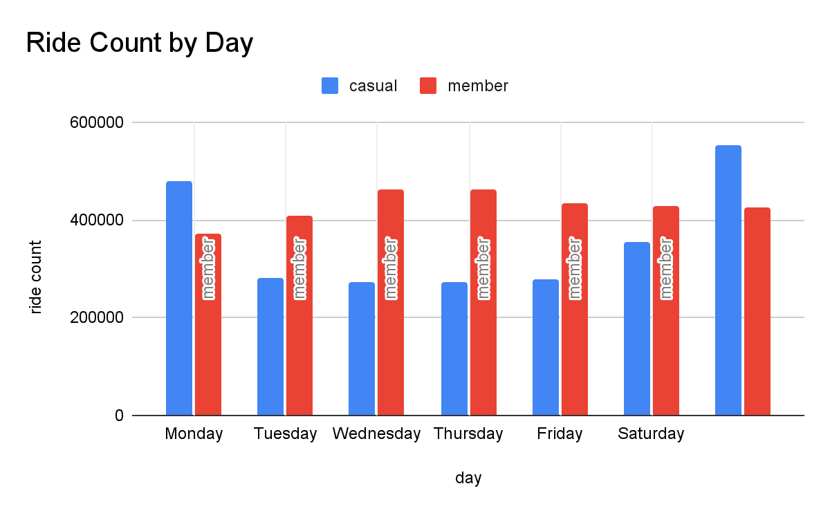

Slide 8
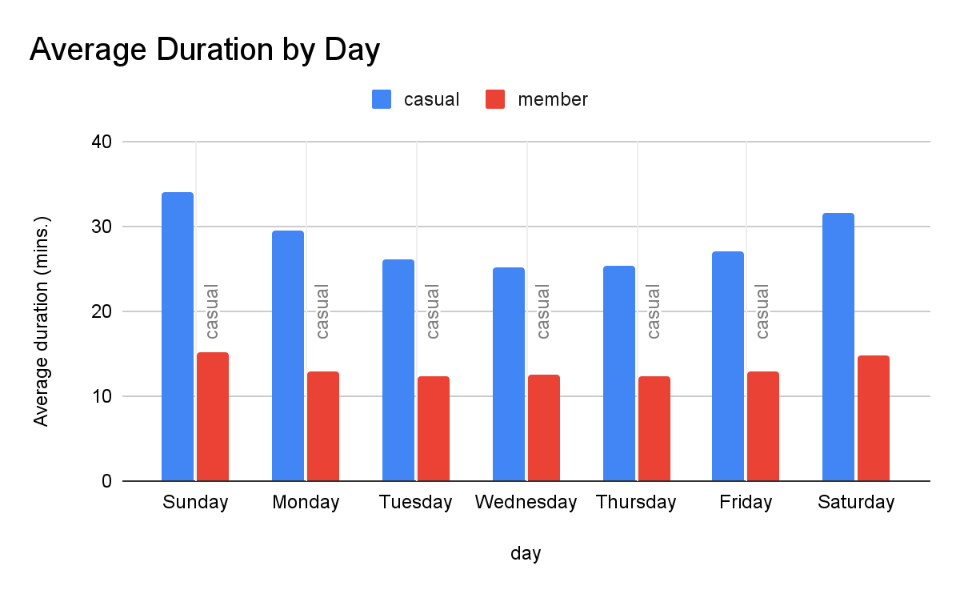

Slide 9
Observation
Members
Steady rider base.
Continue to ride during the winter.
Usage increases on weekends but doesn’t drop off on the weekdays.
Members are most likely working class commuters or students.
Casuals
Prefer to ride during the summer and almost not at all during the winter.
Demand outpaces members during the summer.
Casuals prefer to ride on Fridays & Saturdays.
Casuals are most likely tourists

Slide 10
Both
Members and Casuals both prefer classic bikes followed by electric bikes.
Members and Casuals

Slide 11
Recommendation
Cyclistic should increase the number of classic bikes available to users.
Phase out docked bikes.
Allow only members book classic bikes. This could serve as an incentive for casuals to upgrade their user plan.
Increase number of stations around tourist hotspots.

